Slide 1

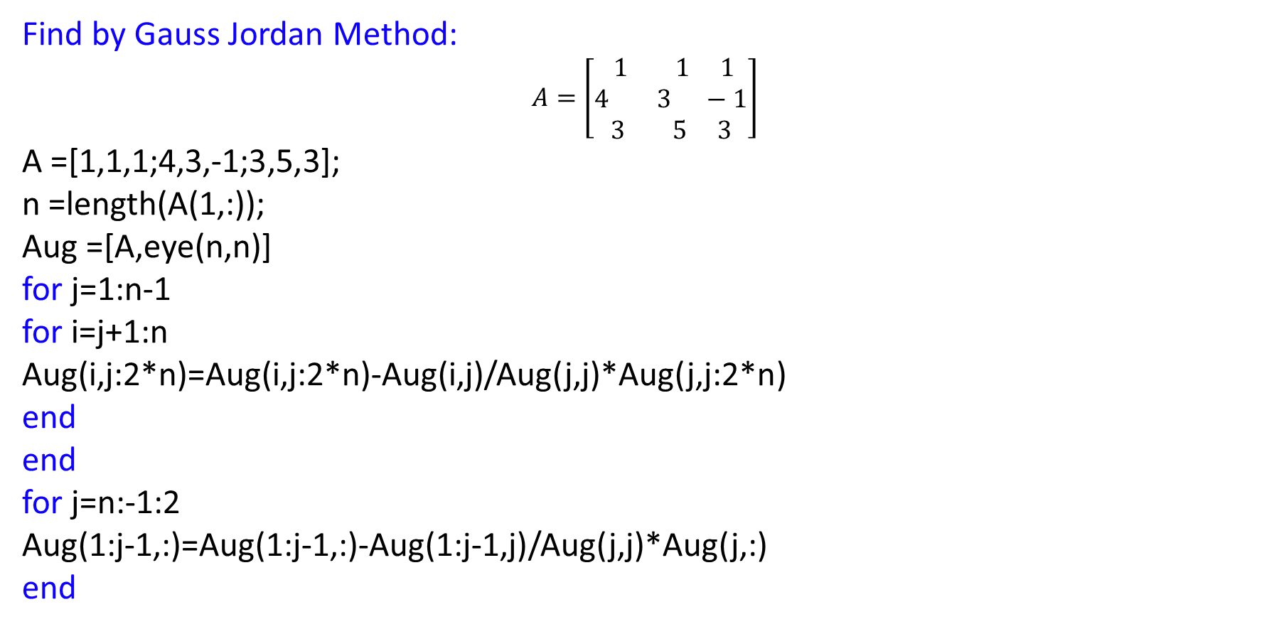
Gauss - Jordan Method To find Inverse
Find by Gauss Jordan Method:
$$A=\left[\begin{aligned} 1 1 1 \\ 4 3 −1 \\ 3 5 3\end{aligned}\right]$$
A =[1,1,1;4,3,-1;3,5,3];
n =length(A(1,:));
Aug =[A,eye(n,n)]
for j=1:n-1
for i=j+1:n
Aug(i,j:2*n)=Aug(i,j:2*n)-Aug(i,j)/Aug(j,j)*Aug(j,j:2*n)
end
end
for j=n:-1:2
Aug(1:j-1,:)=Aug(1:j-1,:)-Aug(1:j-1,j)/Aug(j,j)*Aug(j,:)
end

Slide 2
Gauss - Jordan Method To find Inverse
for j=1:n
Aug(j,:)=Aug(j,:)/Aug(j,j)
end
B=Aug(:,n+1:2*n)

Slide 3
Gauss - Jordan Method To find Inverse
OUTPUT:
Aug = 1 1 1 1 0 0 4 3 -1 0 1 0 3 5 3 0 0 1
Aug = 1 1 1 1 0 0 0 -1 -5 -4 1 0 3 5 3 0 0 1 Aug = 1 1 1 1 0 0 0 -1 -5 -4 1 0 0 2 0 -3 0 1
Aug = 1.0000 0 0 1.4000 0.2000 -0.4000 0 -1.0000 0 1.5000 0 -0.5000 0 0 -10.0000 -11.0000 2.0000 1.0000 Aug = 1.0000 0 0 1.4000 0.2000 -0.4000 0 1.0000 0 -1.5000 0 0.5000 0 0 -10.0000 -11.0000 2.0000 1.0000
Aug = 1 1 1 1 0 0 0 -1 -5 -4 1 0 0 0 -10 -11 2 1 Aug = 1.0000 1.0000 0 -0.1000 0.2000 0.1000 0 -1.0000 0 1.5000 0 -0.5000 0 0 -10.0000 -11.0000 2.0000 1.0000
Aug = 1.0000 0 0 1.4000 0.2000 -0.4000 0 -1.0000 0 1.5000 0 -0.5000 0 0 -10.0000 -11.0000 2.0000 1.0000
Aug = 1.0000 0 0 1.4000 0.2000 -0.4000 0 1.0000 0 -1.5000 0 0.5000 0 0 1.0000 1.1000 -0.2000 -0.1000 B = 1.4000 0.2000 -0.4000 -1.5000 0 0.5000 1.1000 -0.2000 -0.1000

Slide 4


Gauss - Jordan Method To find Inverse
Practice Problems:
$$A=\left[\begin{matrix}1 & 2 & 3 \\ 1 & 2 & 4 \\ 1 & 1 & 5\end{matrix}\right]$$
$$A=\left[\begin{matrix}−1 & 2 & 6 \\ −1 & −2 & 4 \\ −1 & 1 & 5\end{matrix}\right]$$

Slide 5
LU Decomposition Method:
%LU Decomposition
Ab = [1 1 -1;3 5 6;7 8 9];
%% Forward Elimination
n= length(A);
L = eye(n);
% With A(1,1) as pivot Element
for i =2:3
alpha = Ab(i,1)/Ab(1,1);
L(i,1) = alpha;
Ab(i,:) = Ab(i,:) - alpha*Ab(1,:);
end
% With A(2,2) as pivot Element
i=3;
alpha = Ab(i,2)/Ab(2,2);
L(i,2) = alpha
Ab(i,:) = Ab(i,:) - alpha*Ab(2,:);
U = Ab(1:n,1:n)

Slide 6
OUTPUT
L = 1.0000 0 0 6.0000 1.0000 0 9.0000 1.0909 1.0000 U = 1 2 3 0 -11 -11 0 0 -17

Slide 7


LU Decomposition Method:
Practice Problems:
$$A=\left[\begin{matrix}1 & 1 & 3 \\ 1 & 2 & 4 \\ 1 & 1 & 5\end{matrix}\right]$$
$$A=\left[\begin{matrix}−1 & 4 & 6 \\ 0 & −2 & 4 \\ 0 & 0 & 5\end{matrix}\right]$$

